Slide 1
Infectious Diseases of prominence in our county.

Slide 2
Polk County Health Report 2020
http://polk.floridahealth.gov/programs-and-services/community-health-planning-and-statistics/_documents/Polk_CHA2020.pdf
Starts on page 166 in the report.
What communicable diseases seem to be of most concern for Polk County?
Is the community seeing increases or decreases in communicable disease occurrence?
Why do you think this may be occurring?

Slide 3
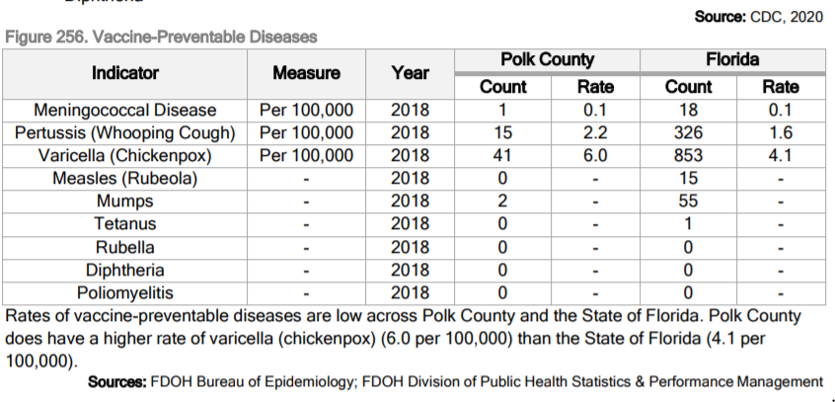
How is Polk County doing compared with the state average?

Slide 4
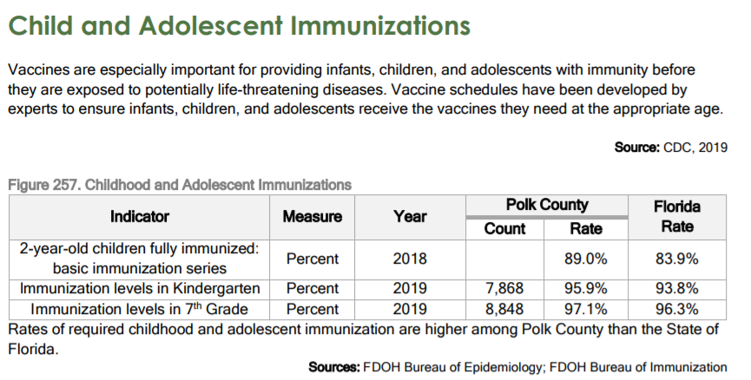
Are Polk Residents getting access to vaccinations for their children?

Slide 5
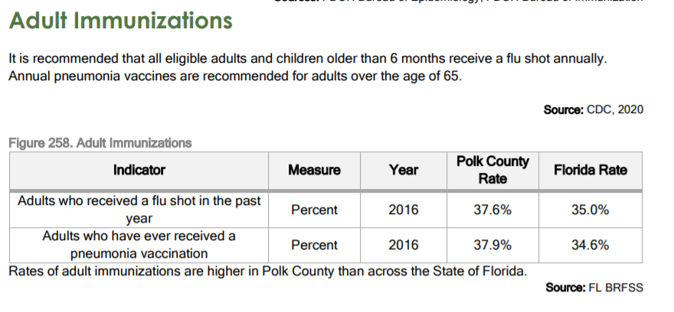
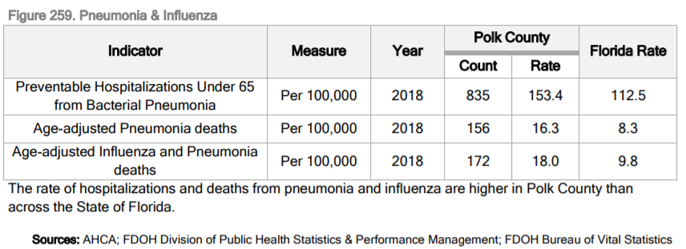
Why does Polk County have a higher death rate when more people are vaccinated in the county compared to the state?

Slide 6
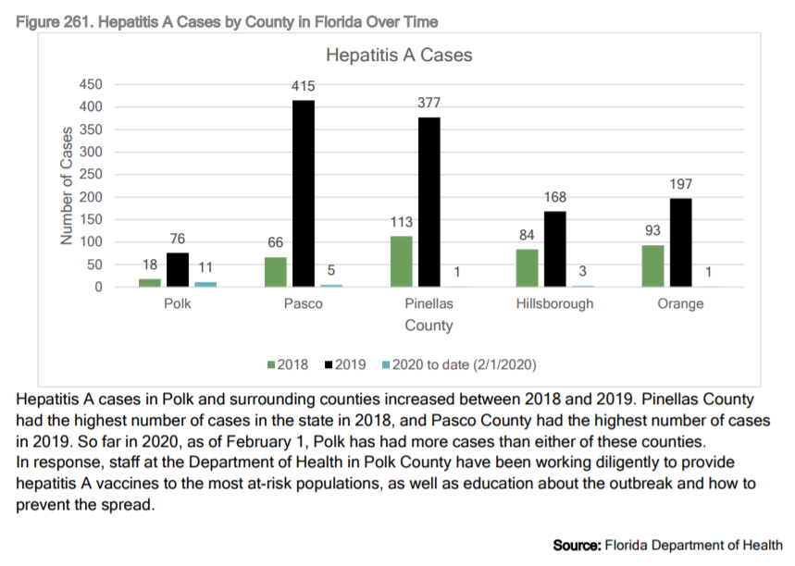
Why does Pasco and Pinellas counties have such high rates of infection compared to Polk County?

Slide 7
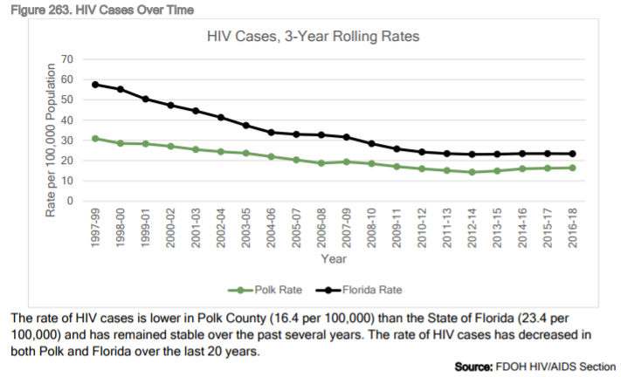

Slide 8
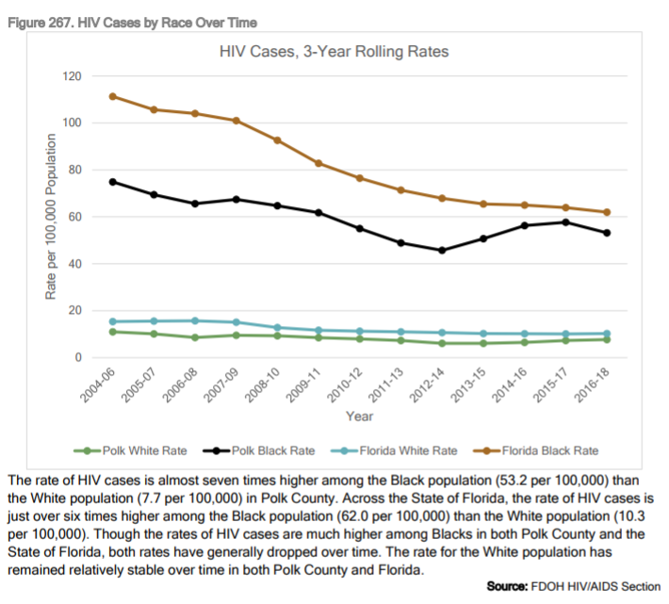
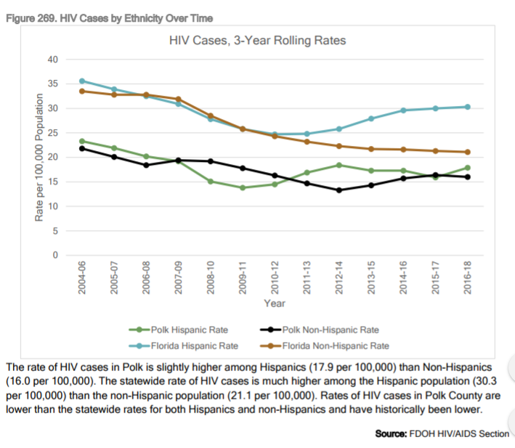

Slide 9
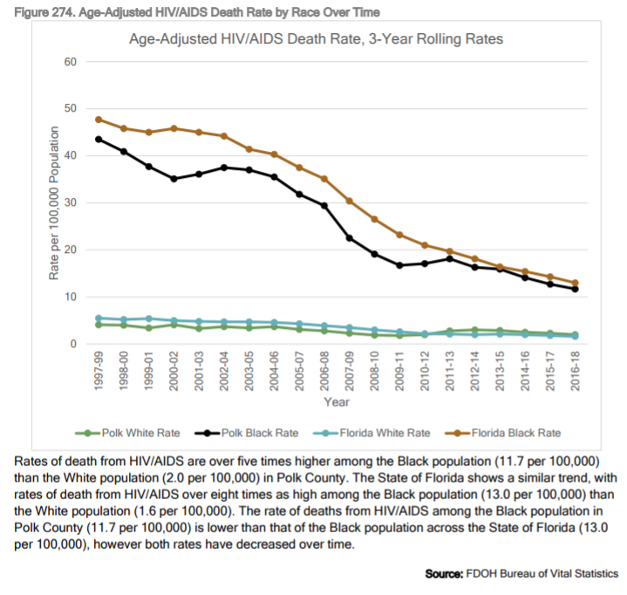
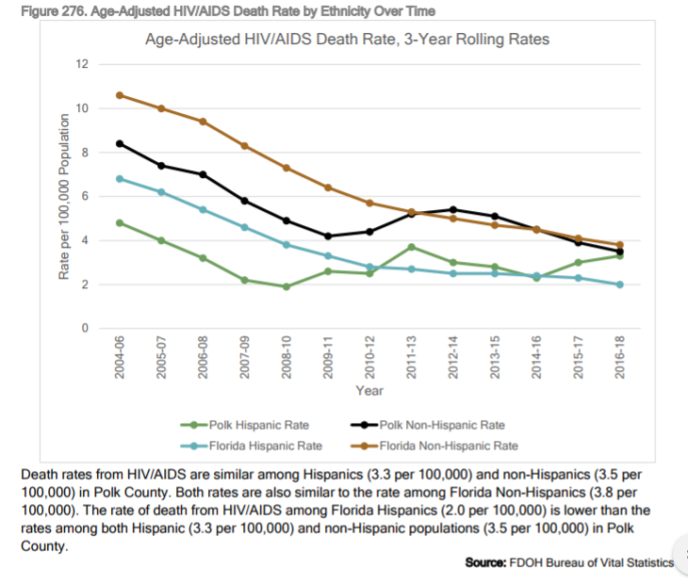

Slide 10
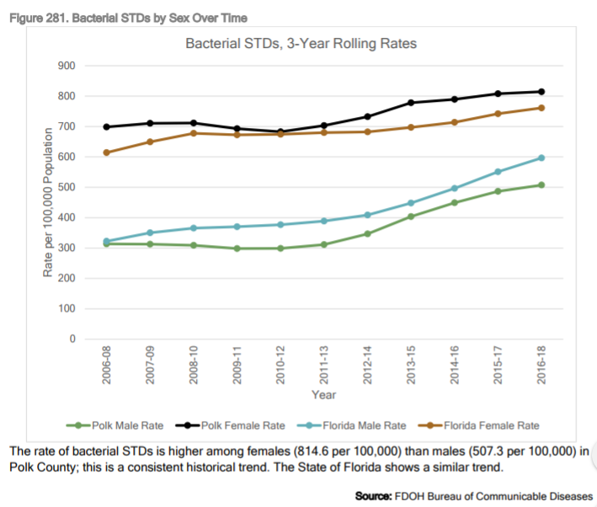
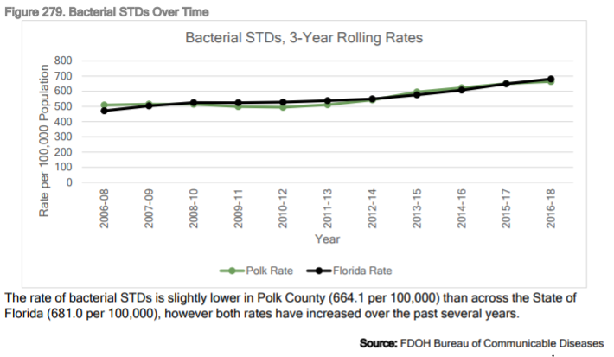
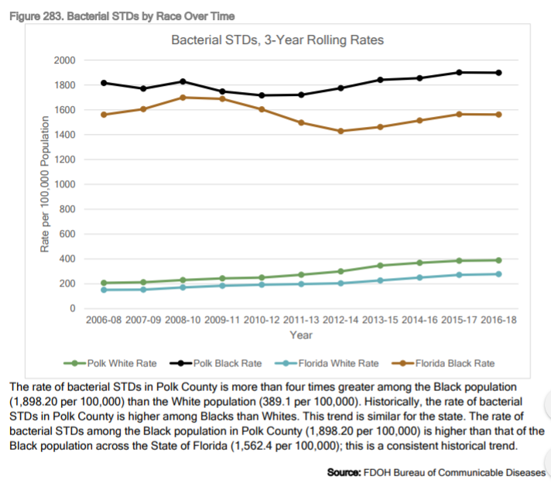
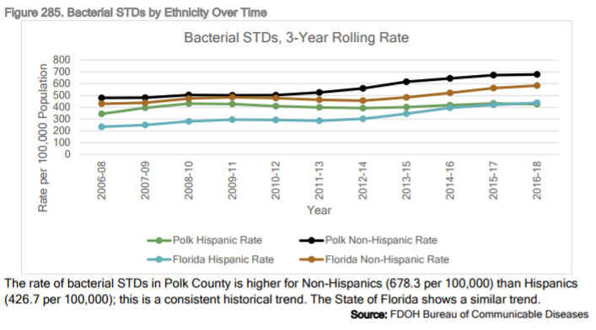

Slide 11
Bacterial STD’s are treatable with antibiotics if the infected individual seeks treatment in the early stages. If left untreated, many bacterial STD’s can lead to organ failure and possibly death. Chlamydia, Gonorrhea and Syphilis are examples.
Viral STD’s do not have a cure. There are new treatments that can help lower the quantity of detectable virus in the body, but this is a treatment that must be maintained for life. HIV and Herpes are examples.
Most STD’s do not show signs or symptoms in the incubation phase making it easy to be passed to others. For some, the incubation phase may last for a long time (months to years) before symptoms show.

Slide 12
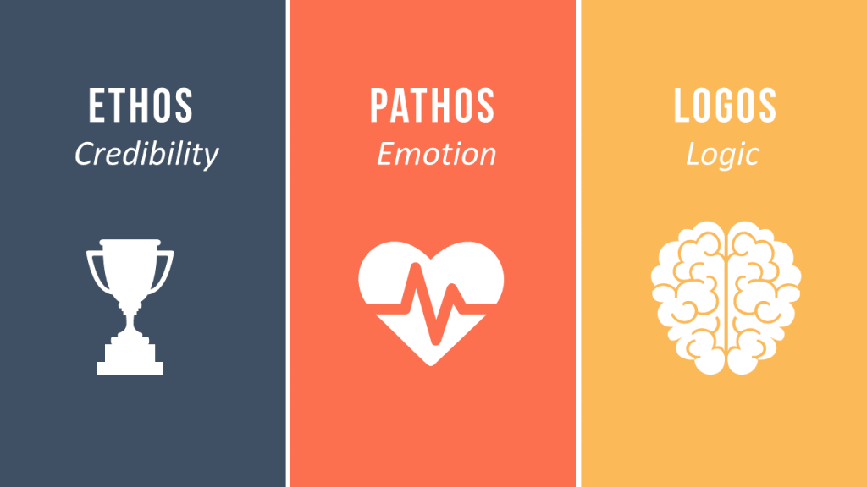
Your challenge – choose your path 2 day project
Create a single document (one page only) advertisement directed to the residents of Polk county or a specific group of residents in Polk County to reduce or continue to reduce the occurrence of a chosen infectious disease. (poster, billboard, magazine ad, etc.)
Include Ethos, Pathos, Logos.
Cite any sources used.
Must be eye-catching, informative and persuasive.
Create a 30 second radio commercial directed to the residents of Polk county or a specific group of residents in Polk County to reduce or continue to reduce the occurrence of a chosen infectious disease.
Include Ethos, Pathos, Logos.
Cite any sources used.
Must be informative, persuasive and memorable. (rhymes, songs and repetition help with this.)

Slide 13
Strategy: Which is more eye-catching/memorable

Slide 14
Compare these audio ads. Which is more memorable?

